Slide 1
System Management Basics
Cybersecurity
Lesson 4.1

Slide 2

By the end of today’s class, you will be able to:
1
Manage processes with the top, ps, and kill commands.
2
Install packages by using apt install.
3
Use newly installed programs such as terminator as a network professional.

Slide 4

Resources and Processes

Slide 5
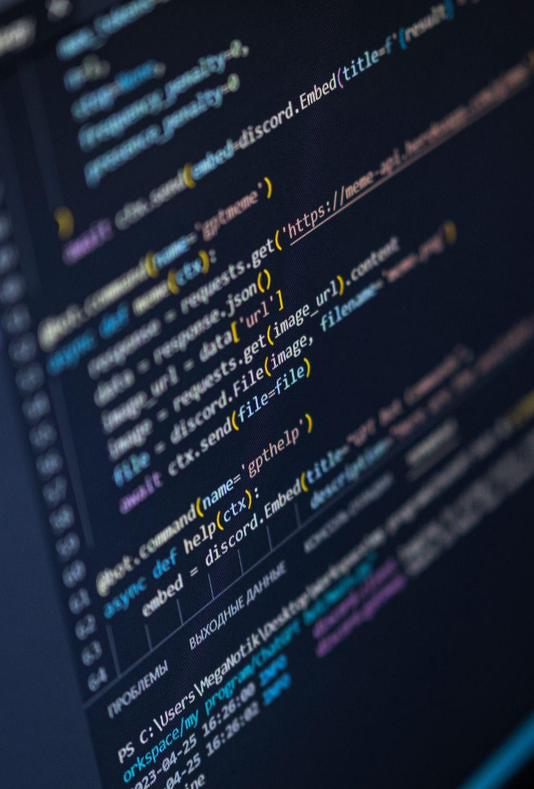
Resources and Processes
Scripts & Programs
Scripts are executable programs that can run a system.
Running programs on a system may:
  Process data
  Modify file system

Slide 6
A process is a program that is running on the system.

Slide 7
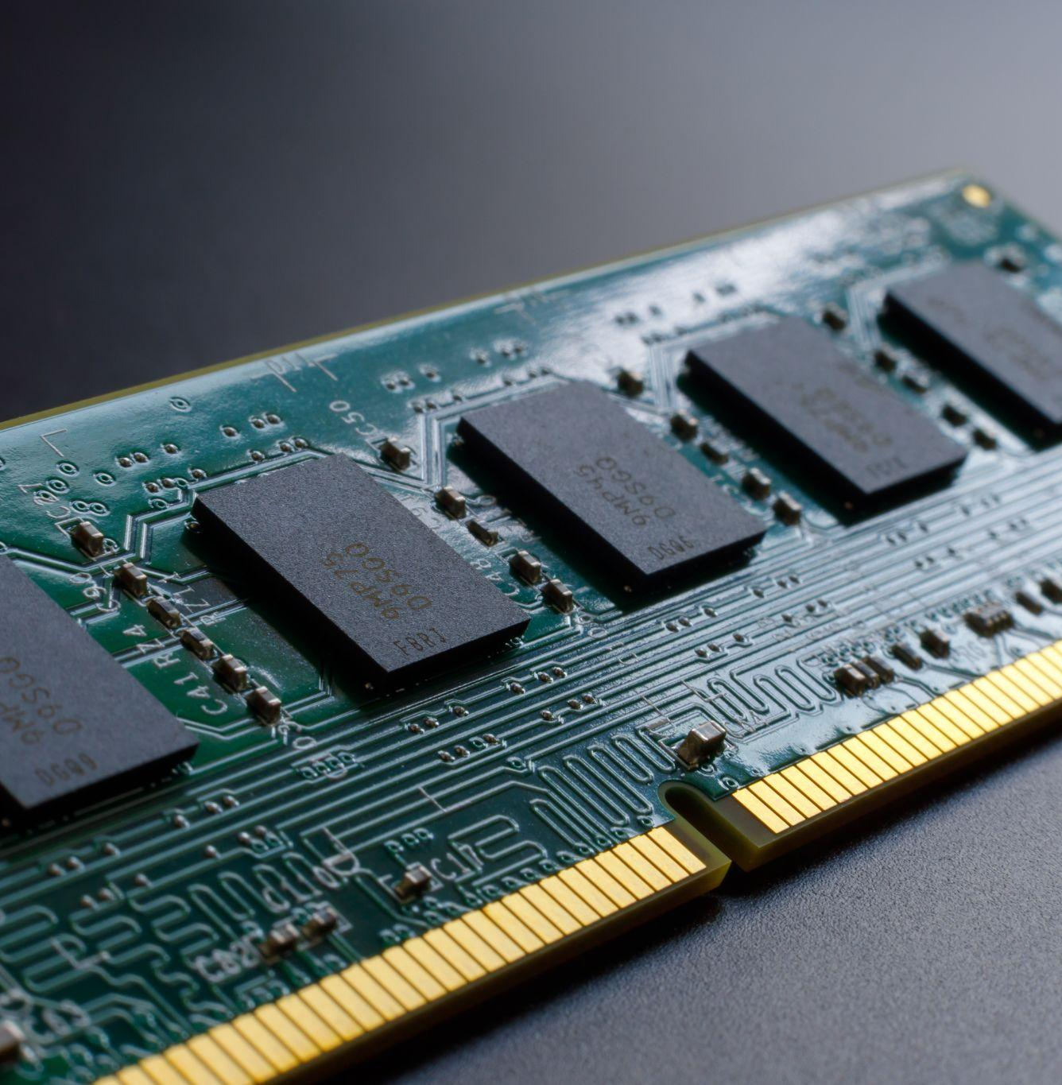
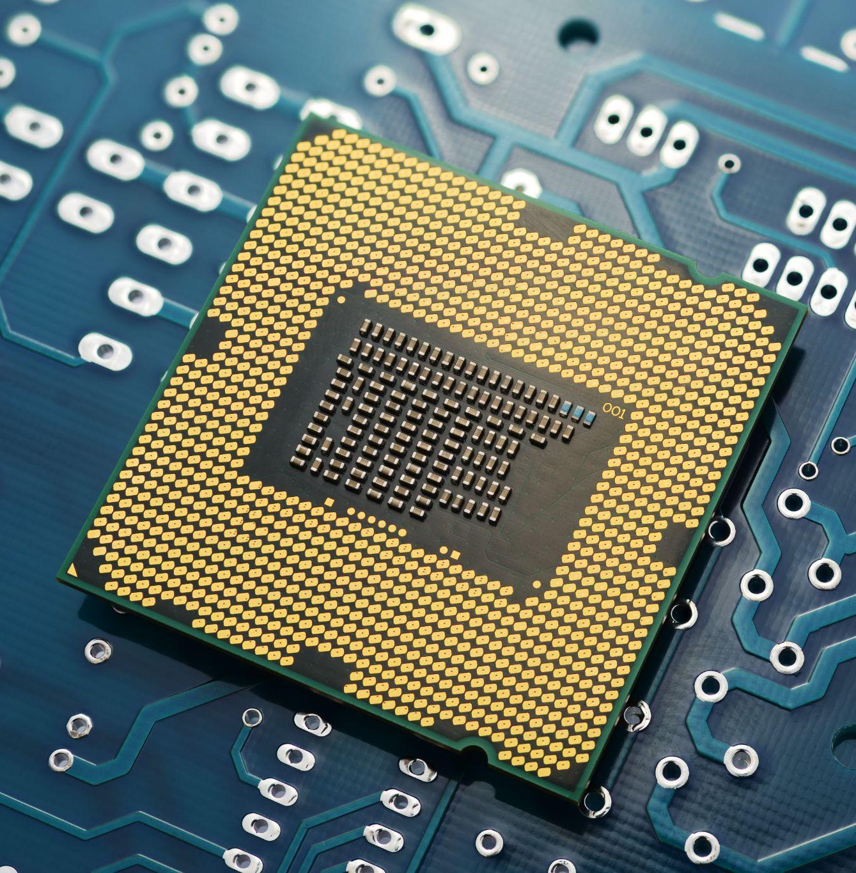
Programs that process, save, and modify data consume a computer's resources.
Memory
CPU

Slide 8
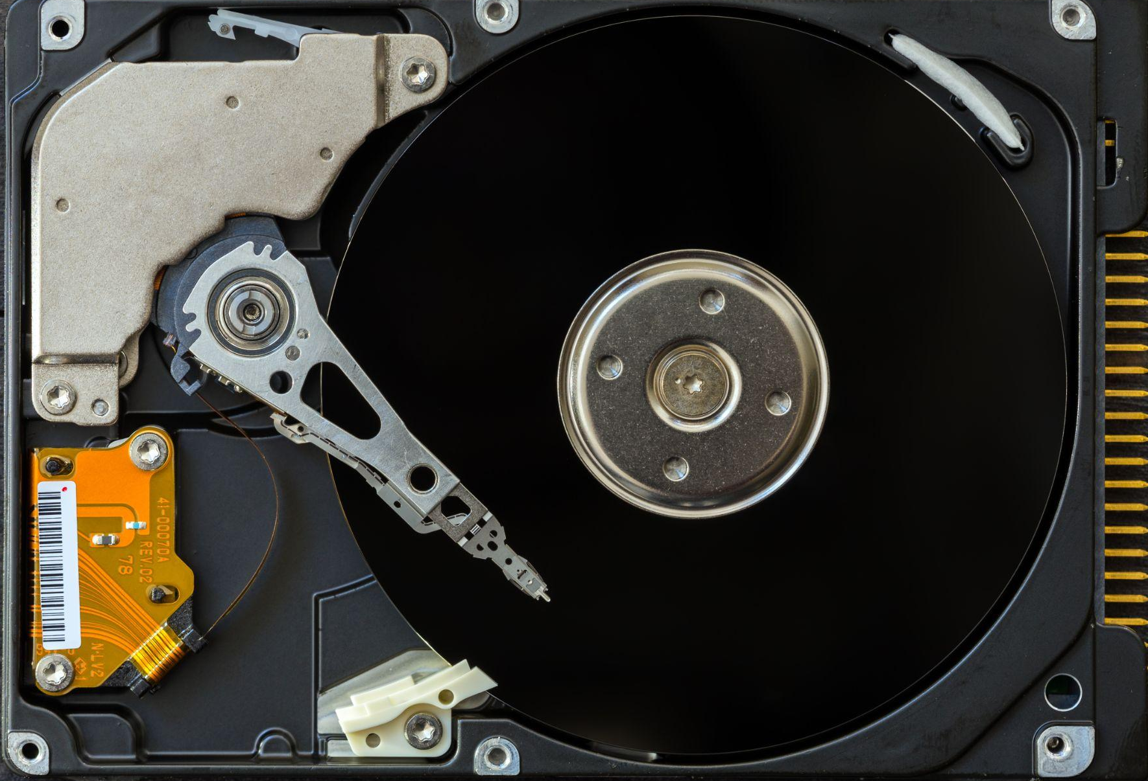
Memory
Memory comes in two forms:
Random Access Memory (RAM) is used to run the program's code.
Disk Space is used to save data permanently.

Slide 9
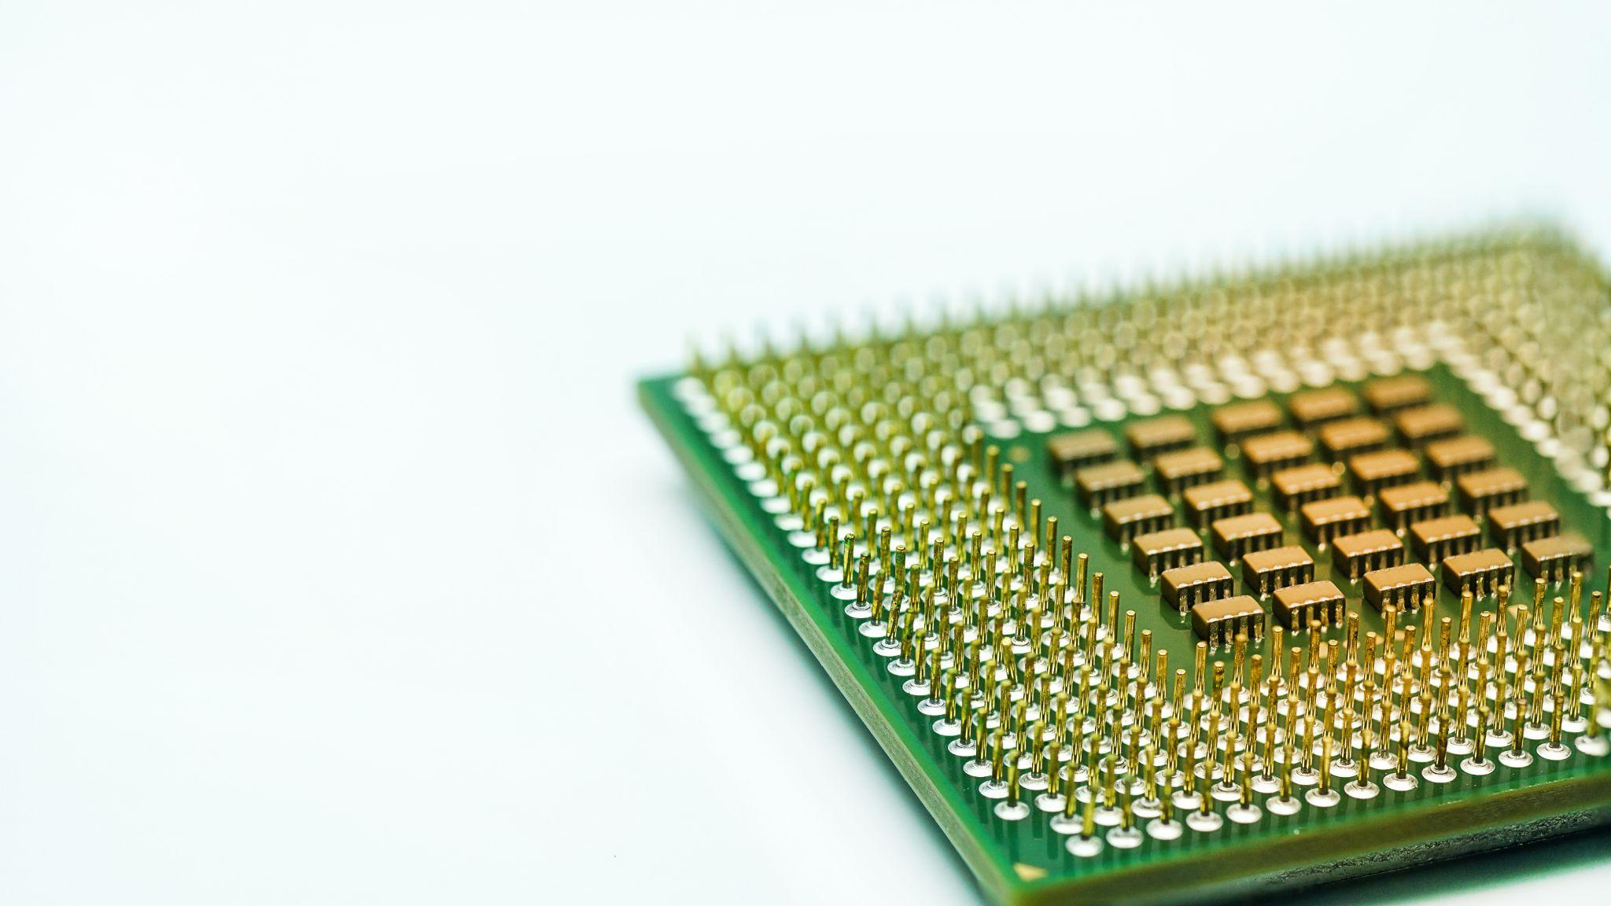
Central Processing Unit (CPU)
The CPU acts as the central brain of a system, determining how much work a process has to do and how "difficult" that work is.
A difficult task, such as encrypting a large file, will use a lot of RAM and/or CPU.
Easier tasks, like executing ls, will require only minimal RAM and/or CPU.

Slide 10
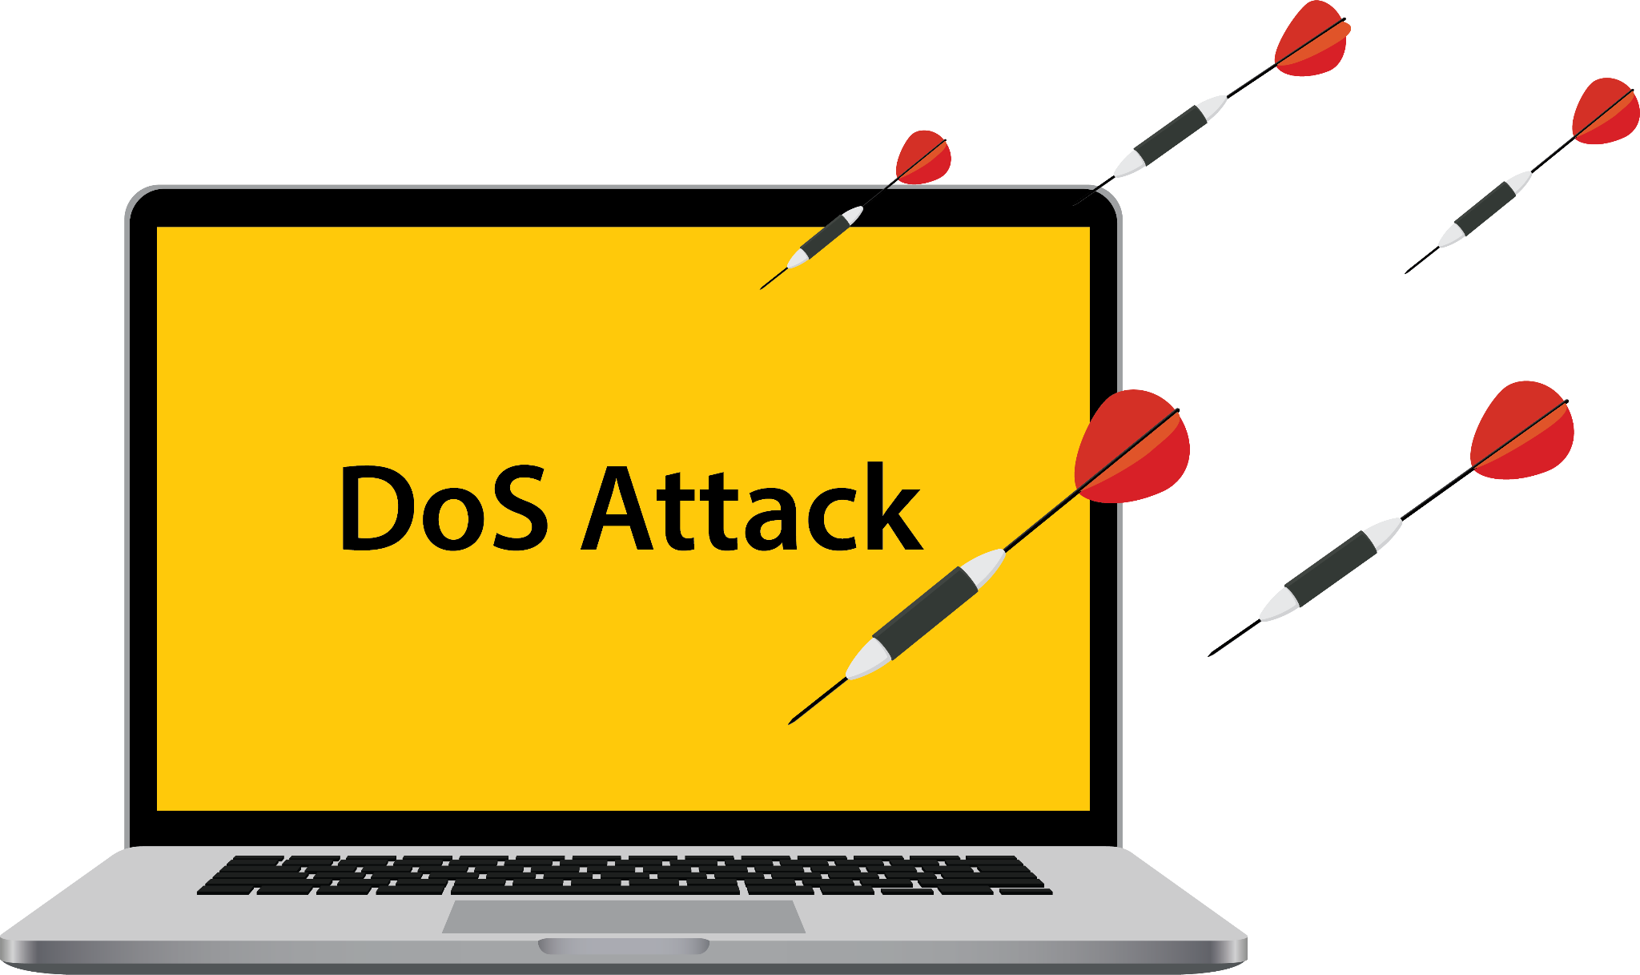
Targeting Resources
Attackers can take advantage of a system’s finite resources.
Attackers can perform denial of service (DoS) attacks by launching processes that eat up memory on a target machine.
This can slow down or crash the machine, making it unavailable to users, thus denying them service.
Notes:
shutterstock_399143986

Slide 11

Targeting Resources
Attackers can also start malicious processes that don’t use a lot of memory, and are therefore difficult to spot without specifically looking for them.
One example is a backdoor process.
This allows attackers
to break into machines undetected.
These don't use much
memory because they make a network connection to the attacker’s machine, then listen for instructions.
Notes:
shutterstock_1095741245

Slide 12
Managing Processes
Linux has several commands for managing processes:
top
ps
kill

Slide 13
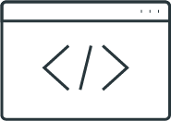
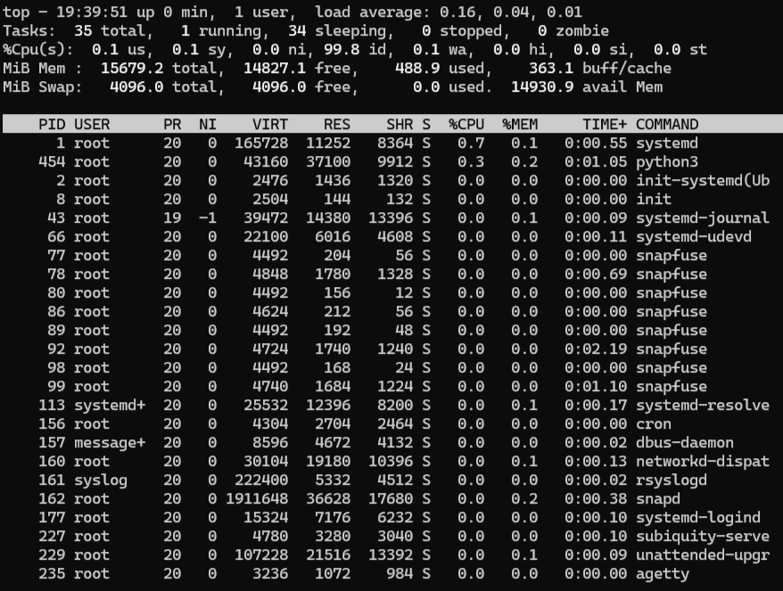
top
top allows you to observe all the running processes in real time.
It is often used by administrators to get a general idea of how the system is running in real time.

Slide 14
ps
ps allows you to take a snapshot of all the running processes on the system.
It is often used with different arguments to observe different subsets of processes.
student:~$ ps
PID TTY TIME CMD
6732 ttys002 00:00:00 /bin/bash
6867 ttys004 00:00:00 /usr/bin/ps
6897 pts/1 00:00:03 /bin/login -f

Slide 15
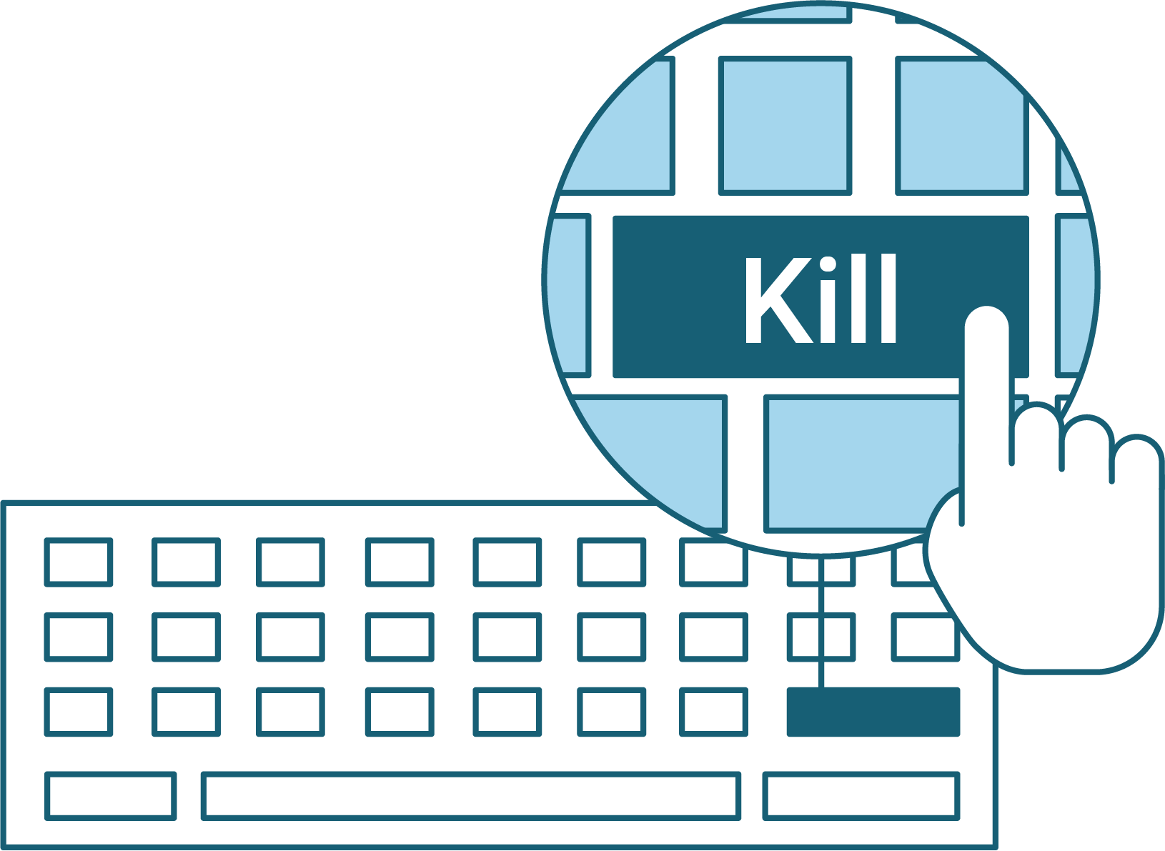
kill
kill is used to stop processes.
It attempts to allow a process to finish what it's doing before it shuts down.

Slide 16
Dynamic analysis is the process of running a potentially malicious script and monitoring its effects.

Slide 17

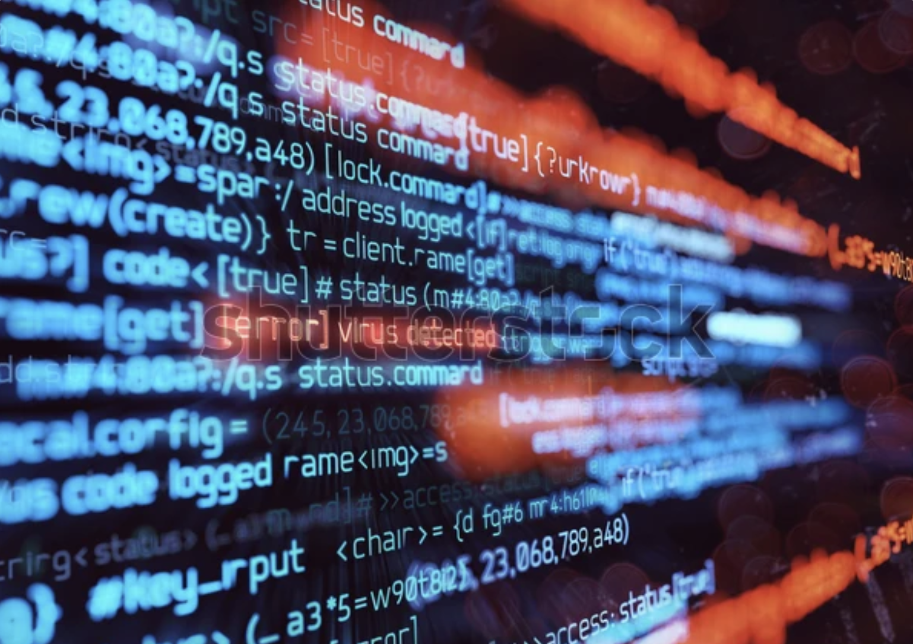
Demonstration Scenario
We will run the suspicious script we found in the /tmp directory during our previous audit.
Use top and ps to understand what it does, and kill the process if needed.
.
Notes:
shutterstock_1888488028

Slide 18

Instructor Demonstration
Inspecting Malicious Files

Slide 19

Demo Summary
System Process Commands
top
ps
Observes all the running processes. Displays information on:
PID
USER
PR
NI
Command
%CPU / %MEM
Takes a snapshot of all the running processes. Run with additional options to show additional information:
-a
-u
-x

Slide 20
Now that we understand the information report top, we’ll run our potentially malicious script to see if that information changes.

Slide 21
Instructor Demonstration
Executing Malicious Files

Slide 22

Demo Summary
Process Commands:
kill
Used to end processes. Syntax options include:
kill <PID>
killall <process_name>

Slide 23
Process Investigation
Previously, you completed a basic audit of the system and found some malicious script files and a user that was not supposed to be on the system.
You will investigate all the processes running on the system to determine if there are any obvious processes that should not be running.
Your senior administrator has asked that you record snapshots of processes as well as review the processes in real time for anything suspicious.
If you find any processes amiss, kill them and add your findings
to your report.
25 Minutes

Slide 27
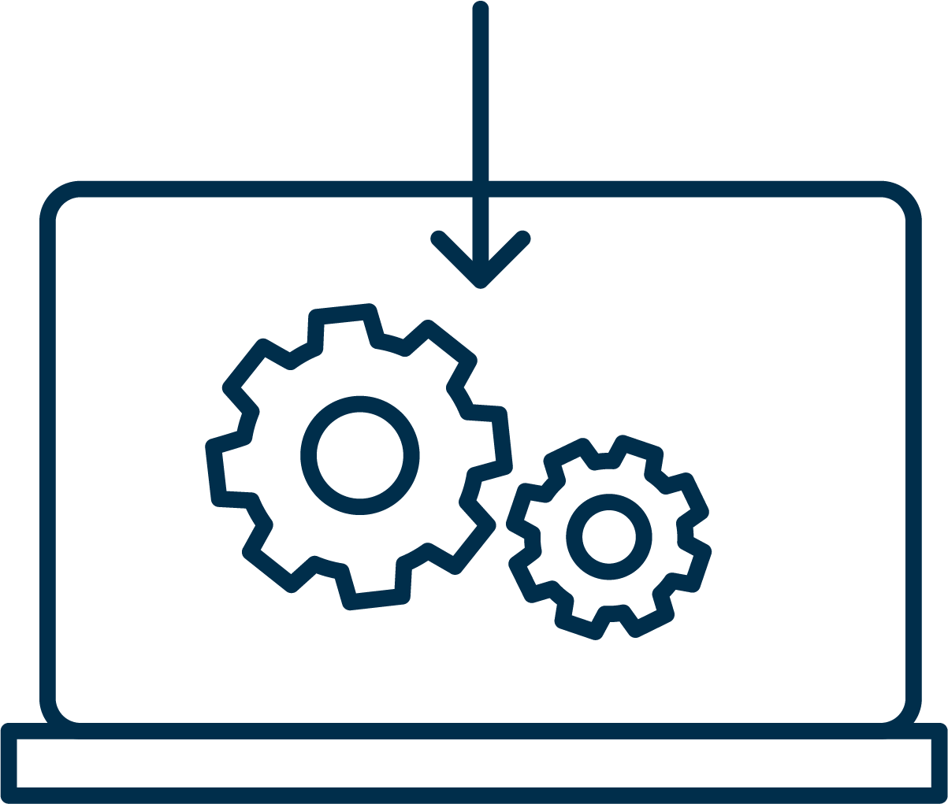

Installing Packages

Slide 28




Packages
Administrators often install additional software to properly harden the machines they manage.
Linux offers downloadable tools called packages.
New packages are installed with a tool called package manager.
We’ll use the Ubuntu package manager, called aptitude, with the command apt.

Slide 29
Package Managers
Utilized through the terminal
01
Simplify the installation and management of software
02
Handle software dependencies automatically
03
Centralized system for software updates and security patches

Slide 30
A package manager is a tool that automates the process of installing, upgrading, configuring, and removing software packages.

Slide 31



Package Managers
Various package managers help simplify software management
01
02
03
Advanced Package Tool (APT)
Yellowdog Updater Modified (YUM)
PackageManager (PACMAN)
Notes:
Shutterstock_792833623 shutterstock_693068344 shutterstock_693068344.png

Slide 32
Since we are using Ubuntu, we will be using apt as our package manager.

Slide 33
Repositories (repos) are collections of software packages that are available for installation.

Slide 34


Repositories
Different types of repositories for installation
Official Repositories
Third-Party Repositories
Personal Package Archives (PPAs)
Maintained by the Linux distribution.
Maintained by other organizations or individuals.
User-maintained repositories that can be added to the system.

Slide 35
Instructor Demonstration
Introduction to apt

Slide 36
Demo Review
Syntax options for apt
sudo apt update | Updates the list of available packages and their versions.
sudo apt upgrade | Installs the newest versions of all packages currently installed.
sudo apt install <package> | Installs a specified package.
sudo apt remove <package> | Removes a specified package.
sudo apt search <package> | Searches for a package in the repositories.
sudo apt install <package> -y | Automatically installs package without confirmation.

Slide 37
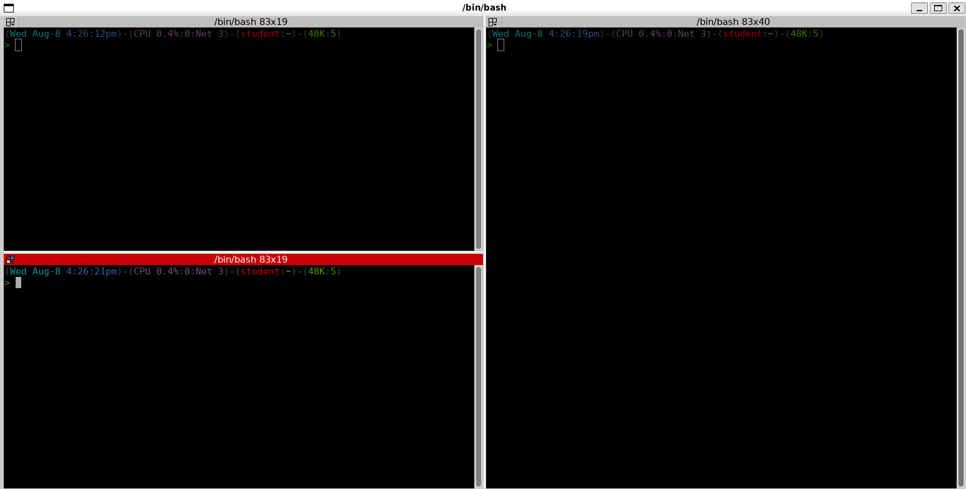
Demonstration Follow Along
While we have been doing everything in the default terminal window, this is not the only option for command line access in Linux.
Terminal has limited functionality with Single Window and Basic Features.
Terminator supports more advanced features:
  Multiple planes
  Tabs
  Customization
  Broadcasting
  Search
Notes:
shutterstock_1888488028

Slide 38
Installing Packages
Now that we have stopped a malicious service from running and completed a basic audit, we're going to cover some of the miscellaneous utilities that we can install onto our VMs.
emacs is a traditional file editor.
cowsay is a utility that takes in input and displays a cow repeating it.
20 Minutes

Slide 41

Recap
System Management Basics
01
Managed processes with the top, ps, and kill commands
02
Explored concepts of RAM and CPU components
03
Installed packages using apt
04
Worked with terminator, utilizing more advanced options

Slide 42
Audit passwords, elevate privileges, and user/group management

